Slide 1
STORM-NeT
AtmoSphere Analytics, LLC
Andrew Brady

Slide 2
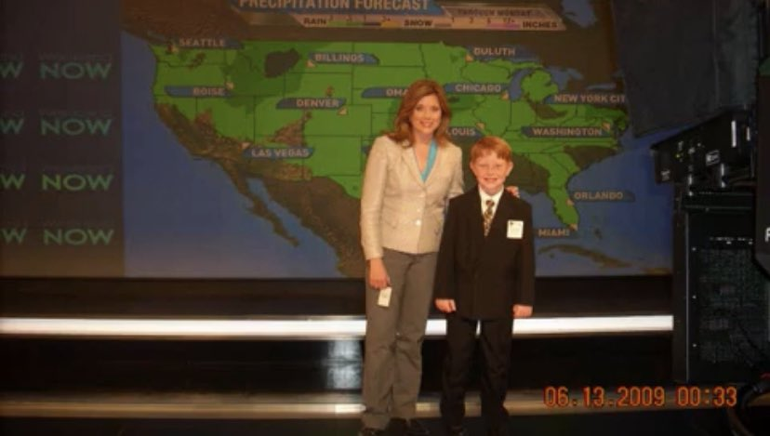
ABOUT ME
Interested in meteorology since I was a child
Mostly self-taught; have had mentors
  Steve Nelson & Adam Baker (NWS Atlanta)
  Rich Thompson (SPC)
  James Rinaldi (Radio Forecast Network)
Radio Forecast Network broadcast forecaster since 2020.
Started AtmoSphere Analytics in 2020 with the MMFS model
  Full physics model, based on WRF
  Added customizations and optimizations with time
Released HazCast in 2022
  Machine learning model using MMFS data as inputs
  Predicts tornadoes, hail, severe wind to 120hrs with low precision, similar to SPC outlooks
Started working on STORM-Net in late 2022, released in Jan 2024 for public testing
I am currently a senior at Mississippi State University, majoring in Geosciences w/ concentration in operational meteorology

Slide 3
What is storm-net?
STORM-Net stands for “Severe and Tornado Real-time Monitoring Network”
State-of-the-art deep learning application that predicts various severe weather hazards with precision in real-time and produces 1hr forecasts (+3hr for tornado)
  Tornadoes (any strength)
  Significant Tornadoes (EF2+)
  Severe T-Storm Wind (50kt+)
  Significant T-Storm Wind (65kt+)
  Severe Hail
  Significant Hail (2”+)
Updates every 2 minutes
Capable of predicting storm motion and longevity
  Shorter swath if storm is expected to weaken
  Longer swath if storm is expected to maintain or strengthen

Slide 4
What is storm-net not?
STORM-Net is NOT a replacement for NWS warnings or watches.
STORM-Net is NOT a perfect technology. It will never be 100% perfect.
STORM-Net is NOT without it’s flaws and biases.
  Ensemble methods help neutralize these biases
  5 member ensemble

Slide 5
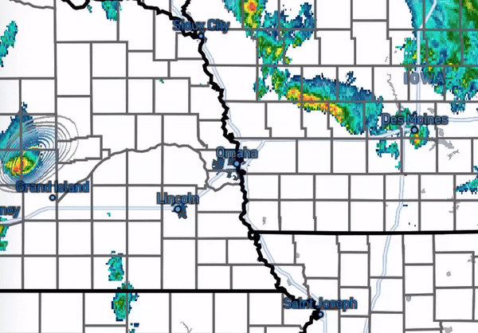
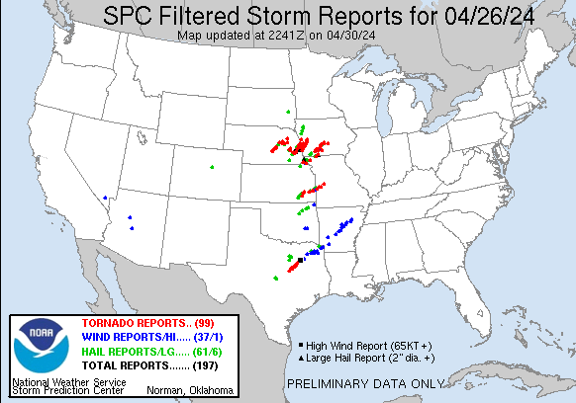
STORM-NET during tornado outbreak
4/26/2024
MULTIPLE EF-3
TORNADOES

Slide 6
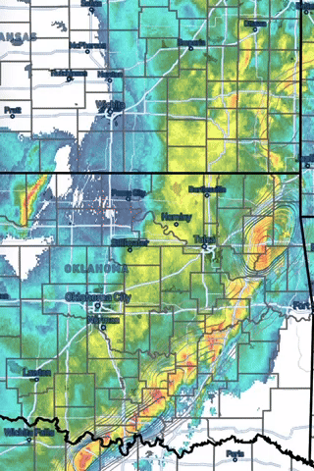
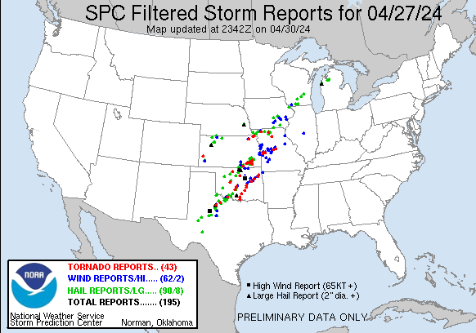
STORM-NET during tornado outbreak
4/27/2024
MULTIPLE EF-3+
TORNADOES

Slide 7
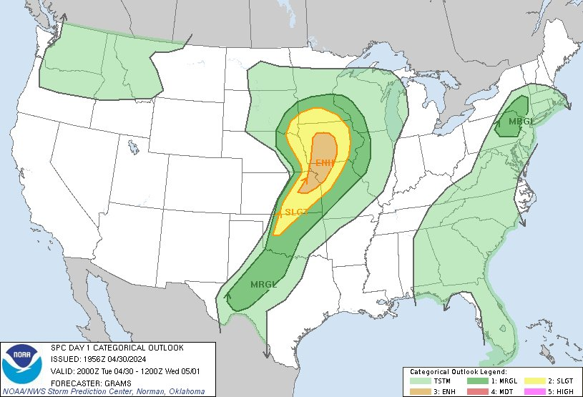
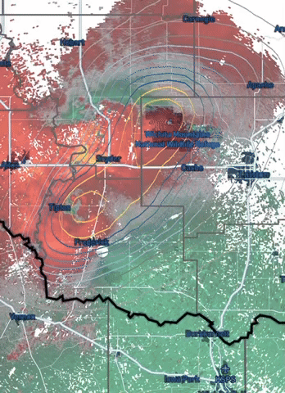
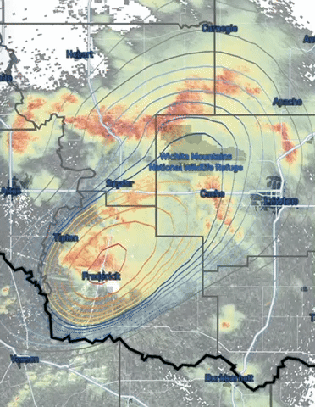
STORM-Net during unexpected strong tornadoes in southern Oklahoma
4/30/2024
SPC 0% tornado risk
marginal overall risk
No tornado watch
Late tornado warning
60min+ STORM-Net lead-time
Likely significant to violent tornado

Slide 8
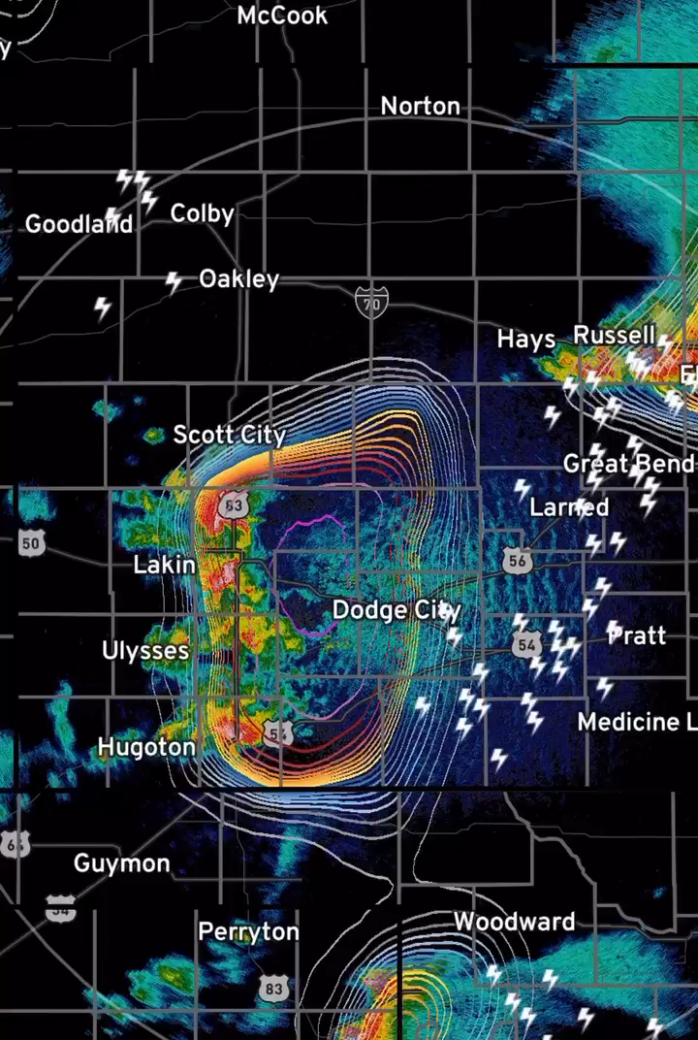
Storm-net damaging wind forecast during Kansas derecho
5/19/2024

Slide 9
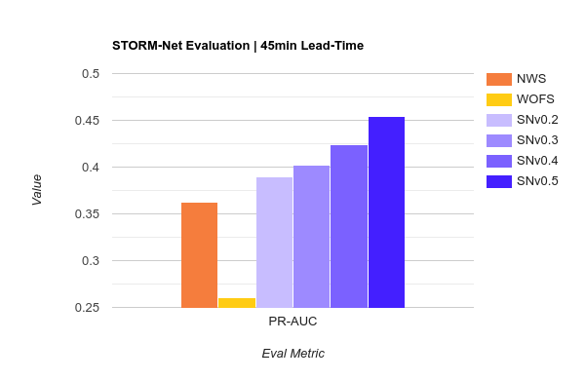
STORM-NET TEST-CASE EVALUATION
***STORM-Net is not a replacement for NWS warnings
NWS warnings are used for evaluation and benchmark purposes
When compared to NWS tornado warnings, STORM-Net out-performs on every metric.
This chart shows PR-AUC. This metric considers false positives, false negatives, and true positives. Higher is better. The metric also considers each grid-point, so unnecessarily large warnings (and risk areas) are penalized.
WOFS, the current “standard” in real-time forecasting lags behind significantly.
*NWS and STORM-Net testing done in-house
WOFS testing based on published results (Flora 2021)

Slide 10
STORM-NET REALTIME EVALUATION
Realtime evaluation during severe weather outbreaks on April 27th, May 6th, May 7th, and May 8th
Evaluated each STORM-Net run during these events, using NWS tornado warnings as a benchmark.
Over 900 STORM-Net runs evaluated!
Used multiple evaluation metrics (F1 Score, PR-AUC, False Alarm Rate).
Found that STORM-Net performs better than human-issued tornado warnings on each metric, especially false alarm rate.
Raw evaluation data is transparently available on our website for the public to inspect.
These evaluation metrics considered 50% STORM-Net probability as the same as a “tornado warning”. Does not consider the inherent benefit of probabilistic forecasts vs deterministic.

Slide 11
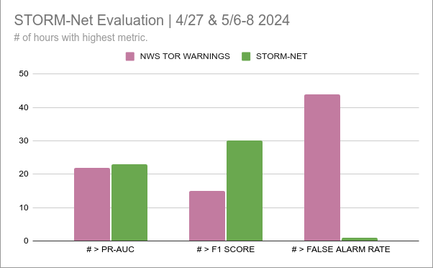
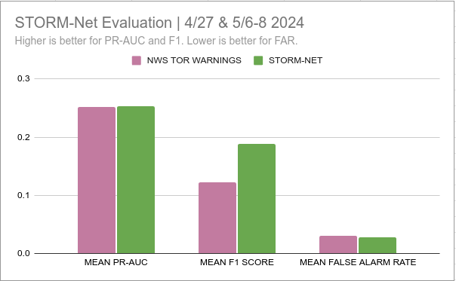
Storm-net realtime evaluation

Slide 12
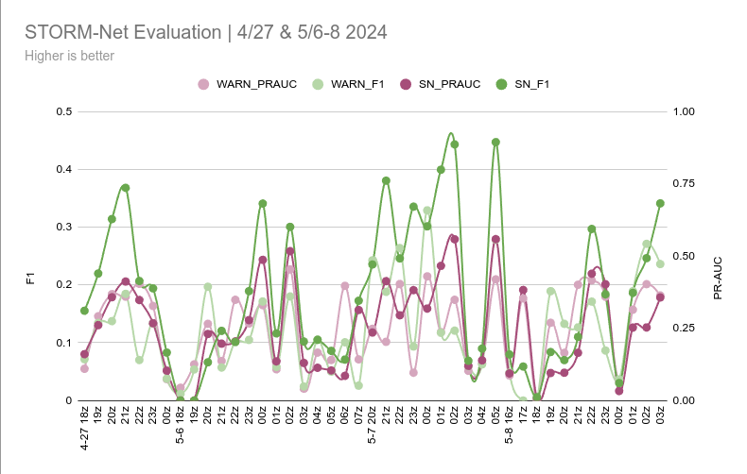
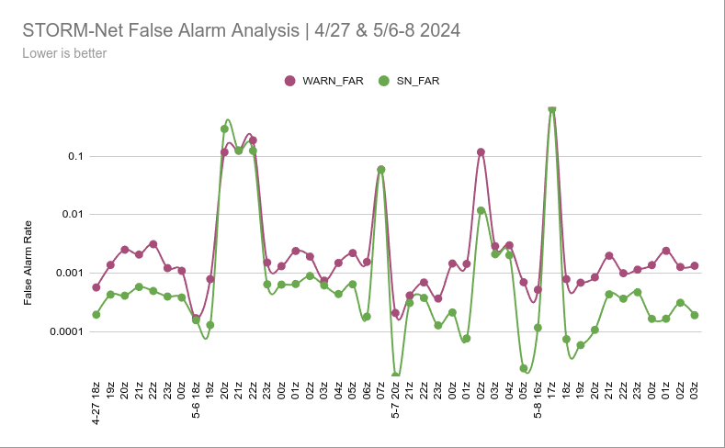
Storm-net realtime evaluation

Slide 13
STORM-Net Testimonials customers and testers
Bobby Boyd, retired NWS meteorologist of 47 years: I’ve been using STORM-Net since the initial early decimal versions and have been impressed with its high predictability of tornadoes and severe storms with good lead time. STORM-Net is simply amazing.
James Bryant, KATV Meteorologist (Little Rock, AR): STORM-Net is proving its worth to everyone.
Zach Covey, Spectrum News Meteorologist: STORM-Net is fantastic. I’m loving seeing how quickly you are advancing it.
Peter Battaglia, Google DeepMind AI Research Scientist: Your work on STORM-Net is very exciting!

Slide 14
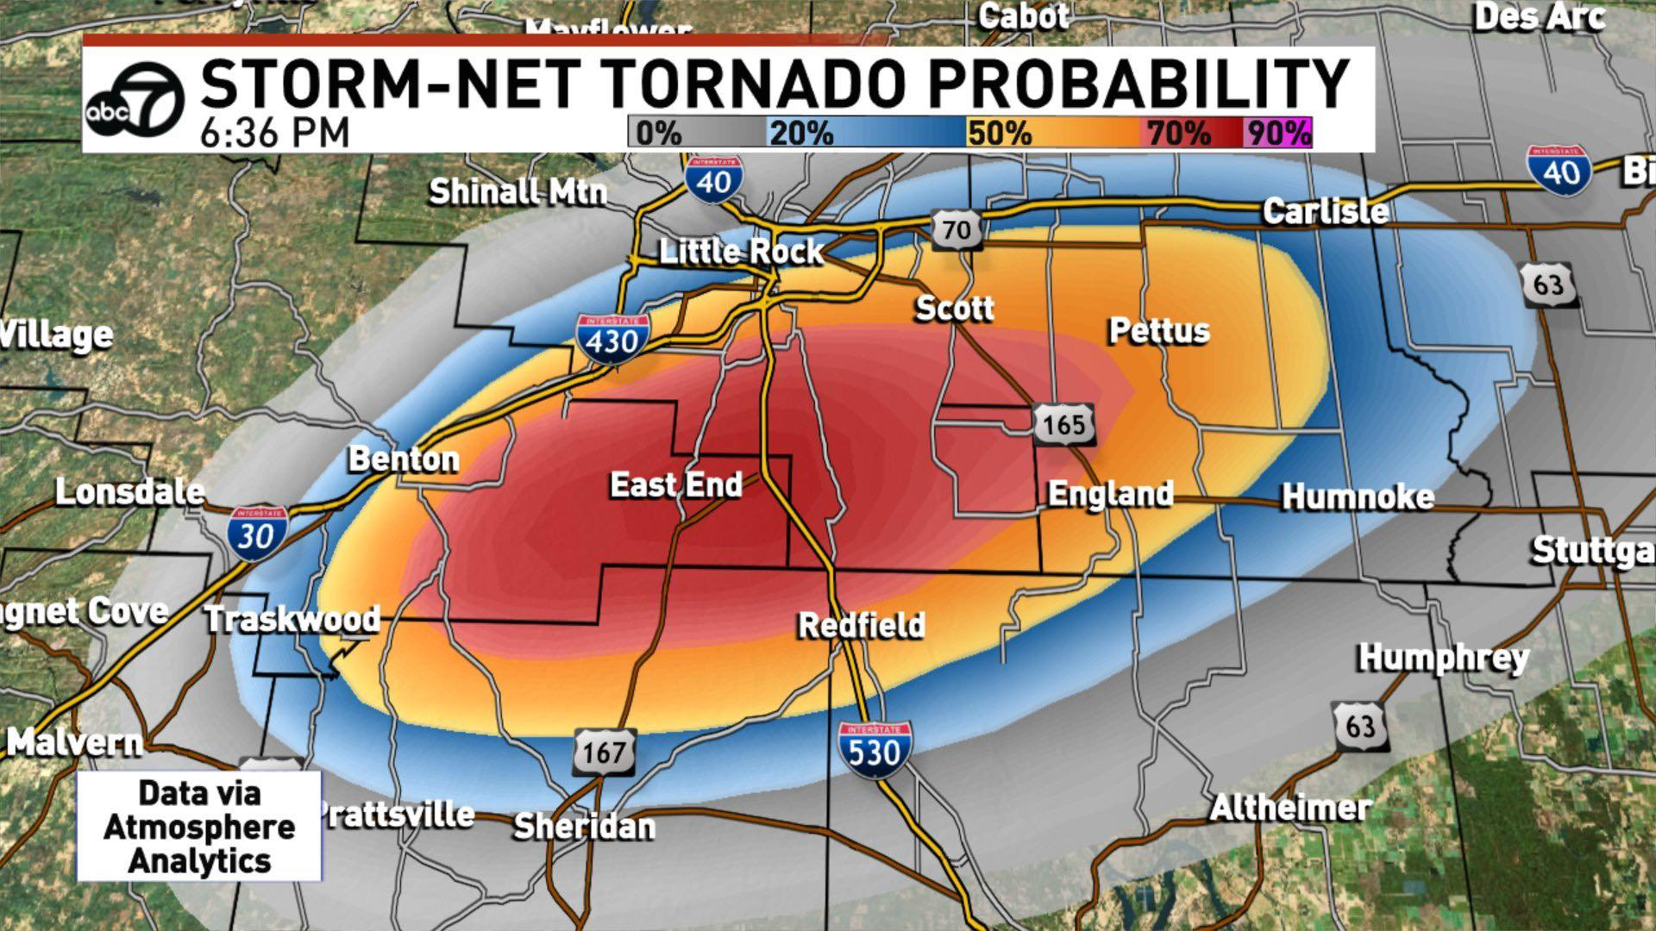
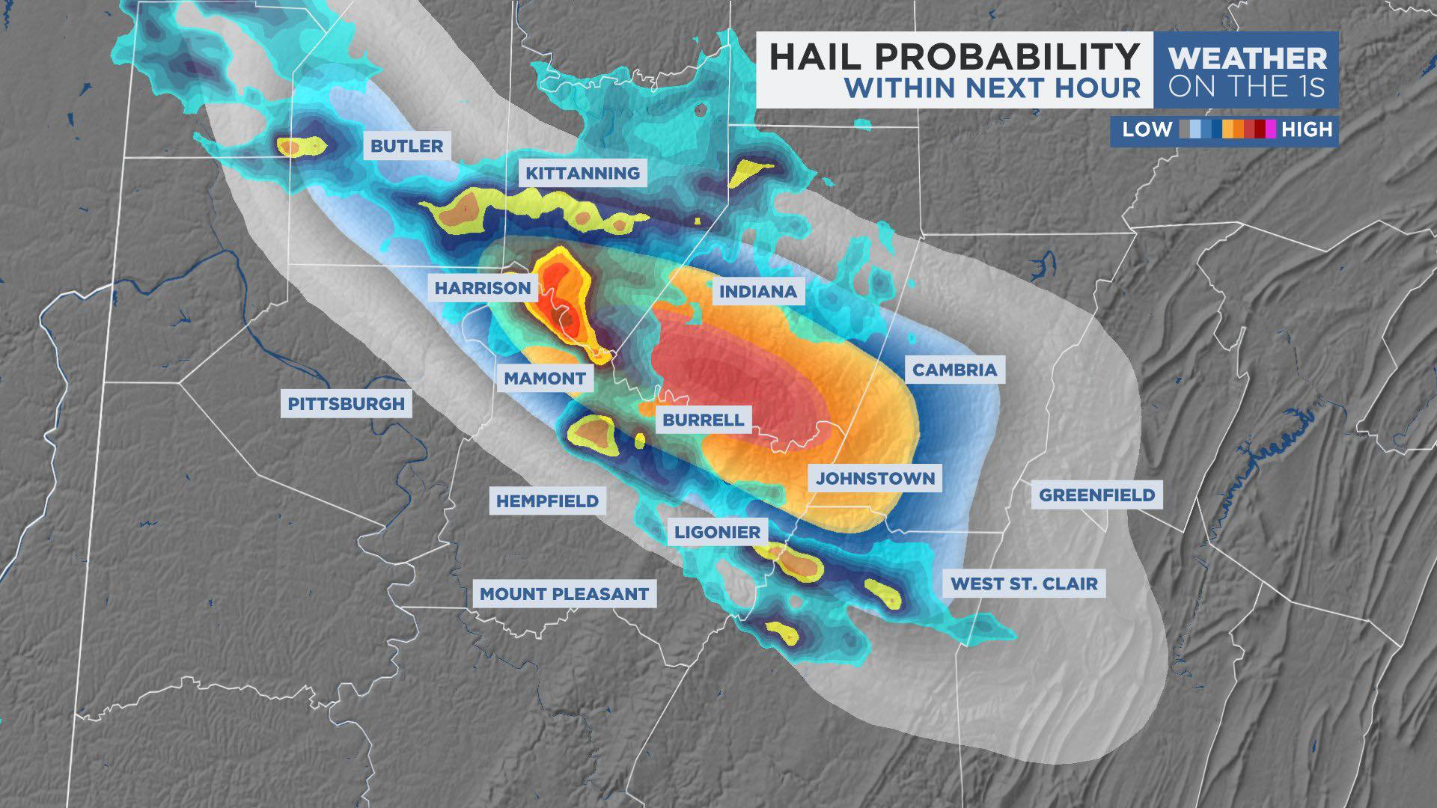
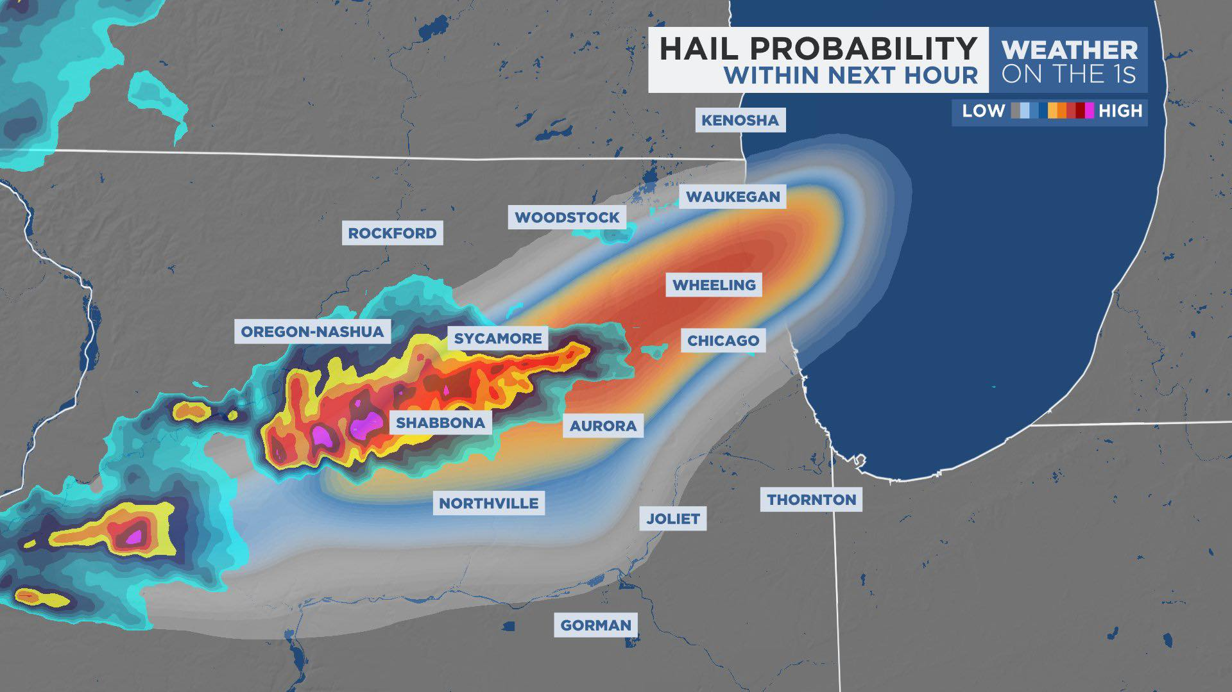
broadcast examples

Slide 15
How does storm-net work?
STORM-Net combines various data sources to predict severe weather hazards in real-time
  Radar
  Observations
  Environmental data
  Land surface data
  And more..
The model is able to “analyze” the data in 3-dimensions to learn where severe weather hazards are most likely within the next hour
Each branch of the model focuses on a different hazard (tornadoes, wind, hail, etc)
The model self-improves with each event by “punishing” itself for incorrect predictions
Trained on data 2019-present (v2 is being trained on data 2014-present)

Slide 16
STORM-Net architecture
3.4 Million parameters x 1.2 Million grid-points x 3 branches
= 12,240,000,000,000 total calculations per run
Radar (Reflectivity, Velocity, etc)
*ZOOM IN*
Small-Scale Analysis
3-D Model Calculations Based on Training
(~12.24 TRILLION Calculations)
OUTPUT PROBABILITIES
Prob of Tornado/Sig-Tor
Prob of Wind/Sig-Wind
Prob of Hail/Sig-Hail
Raw Observational Data
MODEL INPUTS
Derived Environmental and Land-Surface Analysis Data
*ZOOM OUT*
Large-Scale Analysis
POST-PROCESSING
Output probabilities are formatted neatly and sent off
REPEAT EVERY 2 MINUTES

Slide 17
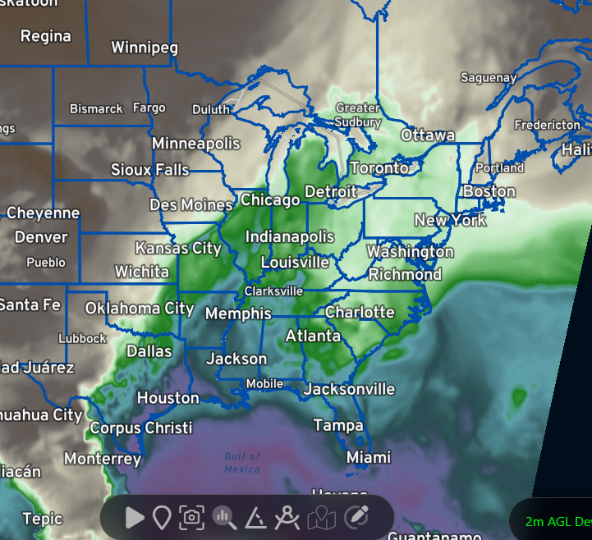
STORM-Net Architecture
*Zoom out” Large scale scan
STORM-Net looks at various conditions across the entire grid (all of the input variables as a dimension)
The model looks at the grid in multiple dimensions (grid width x grid height x input channels (features))
Knows which input channels are most important in different setups based on training.
In these “zoomed out” stages, STORM-Net is able to figure out large-scale spatial features such as thunderstorm clusters, warm fronts, cold fronts, warm sectors, areas of high cape and high shear, etc

Slide 18
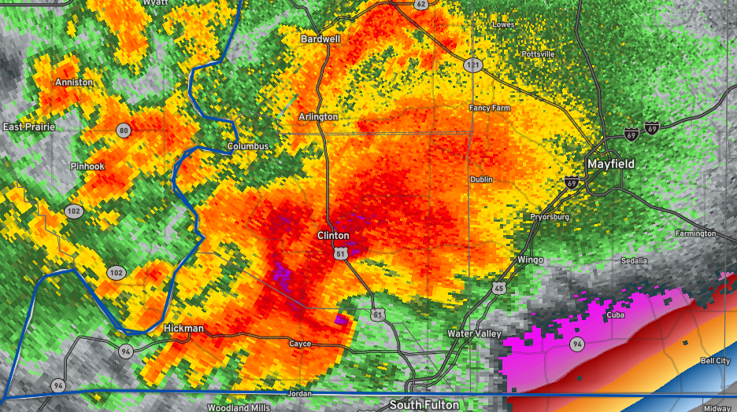
STORM-Net Architecture
*Zoom in” small scale scan
STORM-Net looks at conditions in chunks across the grid.
Importance is placed on different chunks and different features based on surrounding features.
STORM-Net scans for small-scale features that it has learned to spot
  Features such as hook echos, rotation signatures, BWER
  May include high-res features and components that are yet to be fully discovered by meteorological science!
STORM-Net uses data from the zoomed out scans and the zoomed in scans, together, to make a final probability map for grid-points across the grid.
STORM-Net finds useful connections between large scale features, small scale features, and everything in-between to make its final predictions.

Slide 19
Case study test case
The following are historical severe weather events that were in the STORM-Net test case archive.
The model has NOT seen these or used them in training.
All times are in UTC
All data shown is publicly available on our website
There are dozens of test cases. We will only explore a specific example.
Others are available on website under “Archive”

Slide 20
Deadly rolling fork, ms tornado march 25th, 2023
Tornado touched down and rapidly intensified as it entered Rolling Fork, MS
Middle of the night, little warning, rapid intensification, low-income community: recipe for catastrophe. Rolling Fork was impacted at 01:08
NWS Tornado Warnings
  First tornado warning for the storm (NOT including Rolling Fork) was issued at 00:46.
  First tornado warning for Rolling Fork was issued at 00:54.
  First tornado emergency for Rolling Fork was issued at 01:05.
STORM-Net featured high accuracy and a 30 minute plus lead-time
  STORM-Net started highlighting Rolling Fork with an elevated tornado risk at 00:38.
  STORM-Net sig-tor probabilities spike (including Rolling Fork) at 00:44.
  STORM-Net probabilities rapidly increased at 00:44, 00:48, and 00:54..

Slide 21
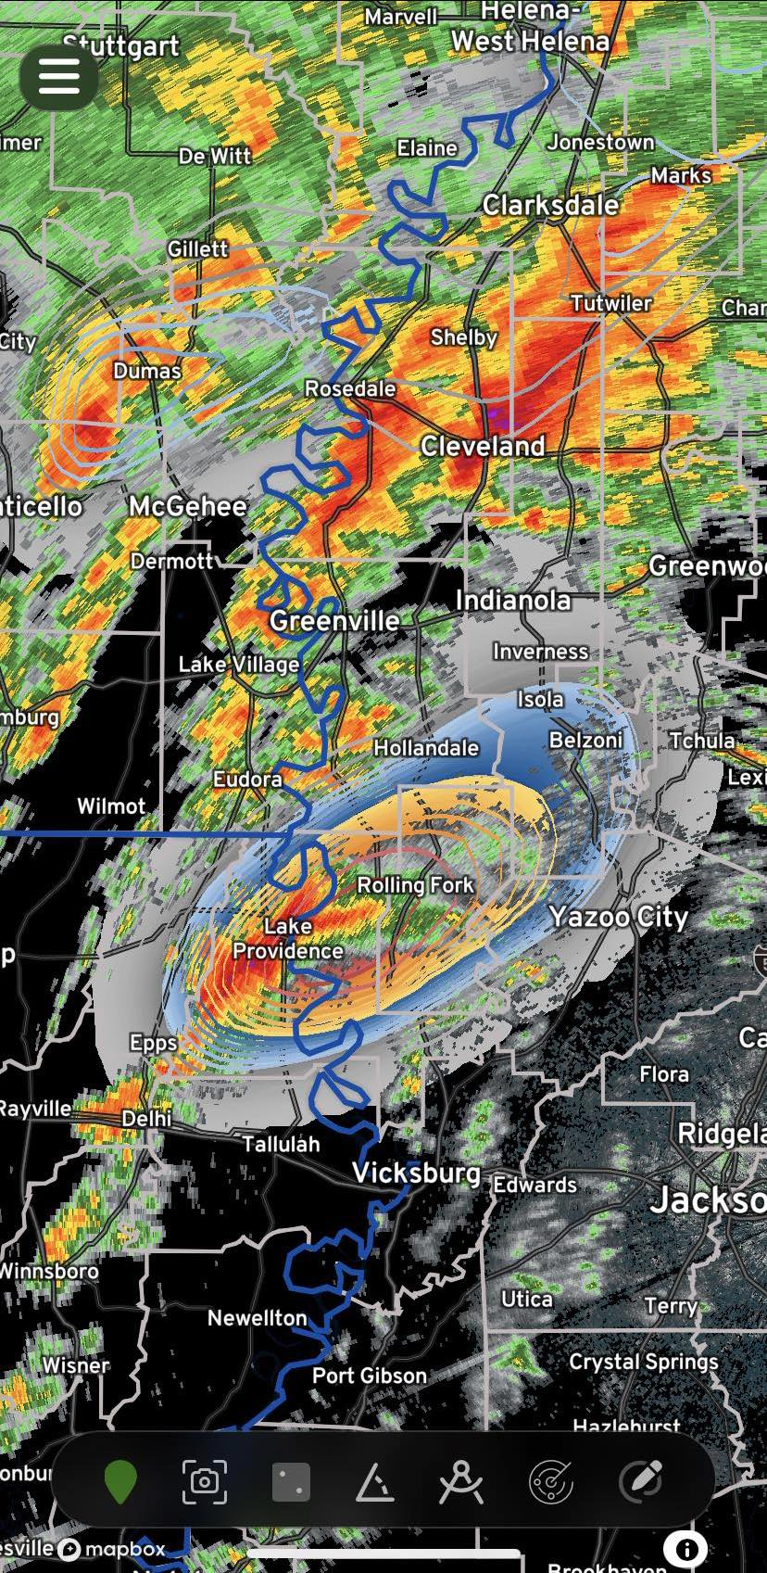
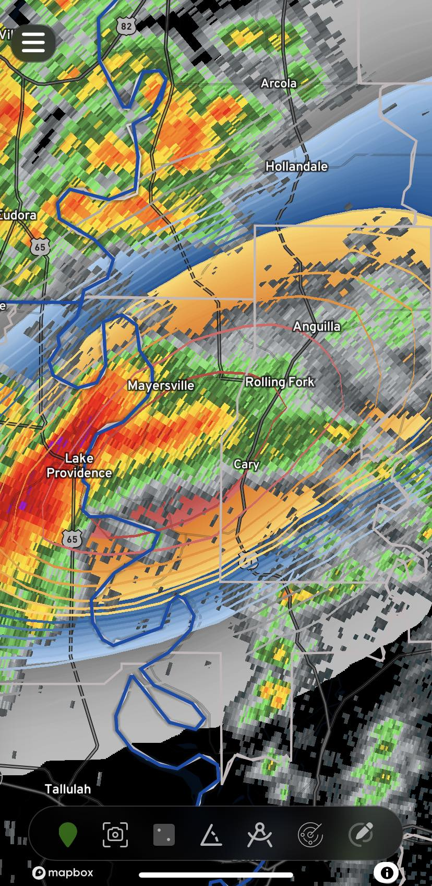
STORM WARNED @ 00:46
ROLLING FORK WARNED @ 00:54
TOR-E @ 01:05
STORM-Net initialized at 00:38. (16 minutes prior to tornado warning)
30 minute lead-time for Rolling Fork, MS | Already in 60%+

Slide 22
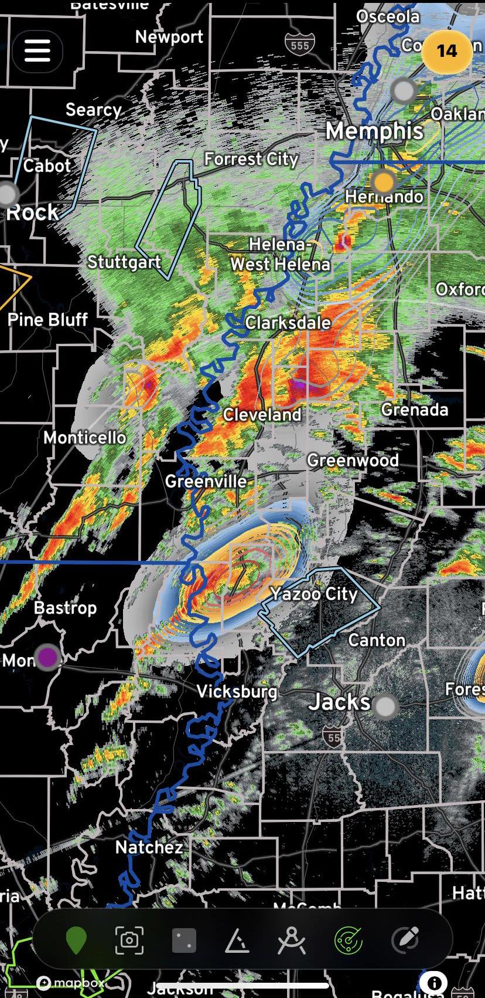
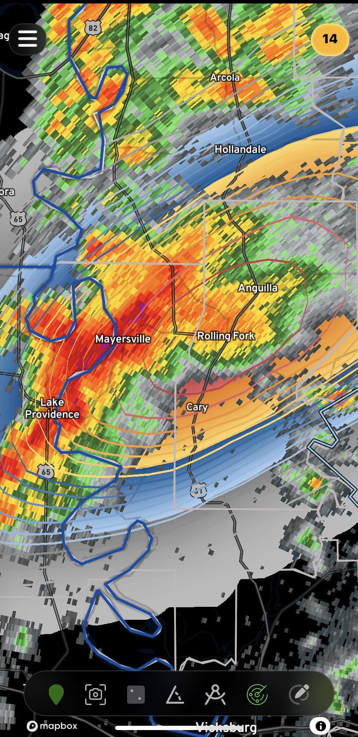
STORM WARNED @ 00:46
ROLLING FORK WARNED @ 00:54
TOR-E @ 01:05
STORM-Net initialized at 00:44. (10 minutes prior to tornado warning)
25 minute lead-time for Rolling Fork, MS | Already in 95%+ and now in sig-tor zone

Slide 23
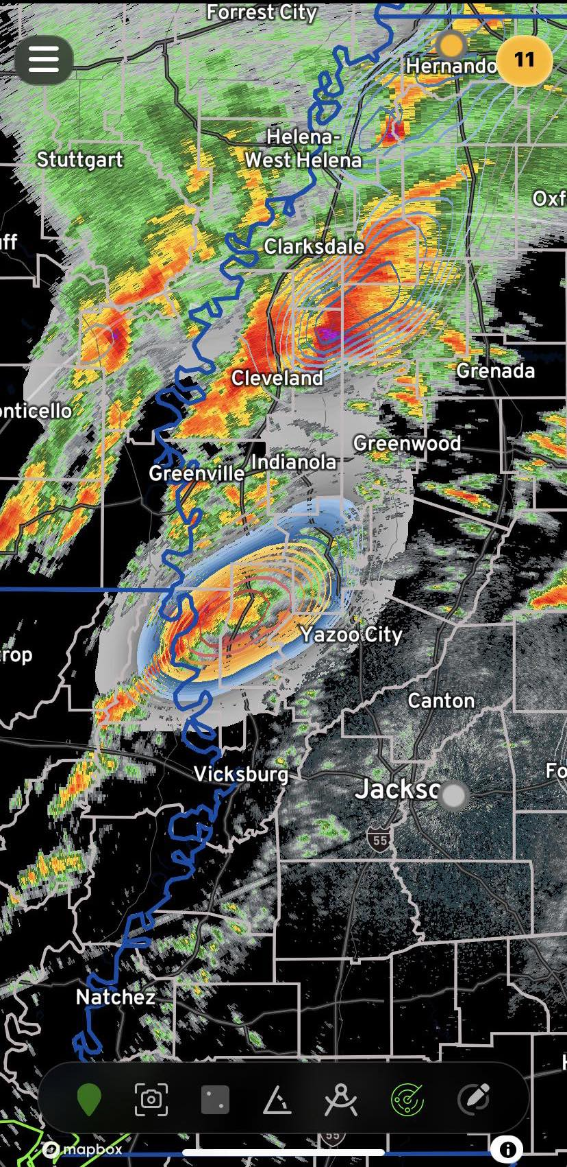
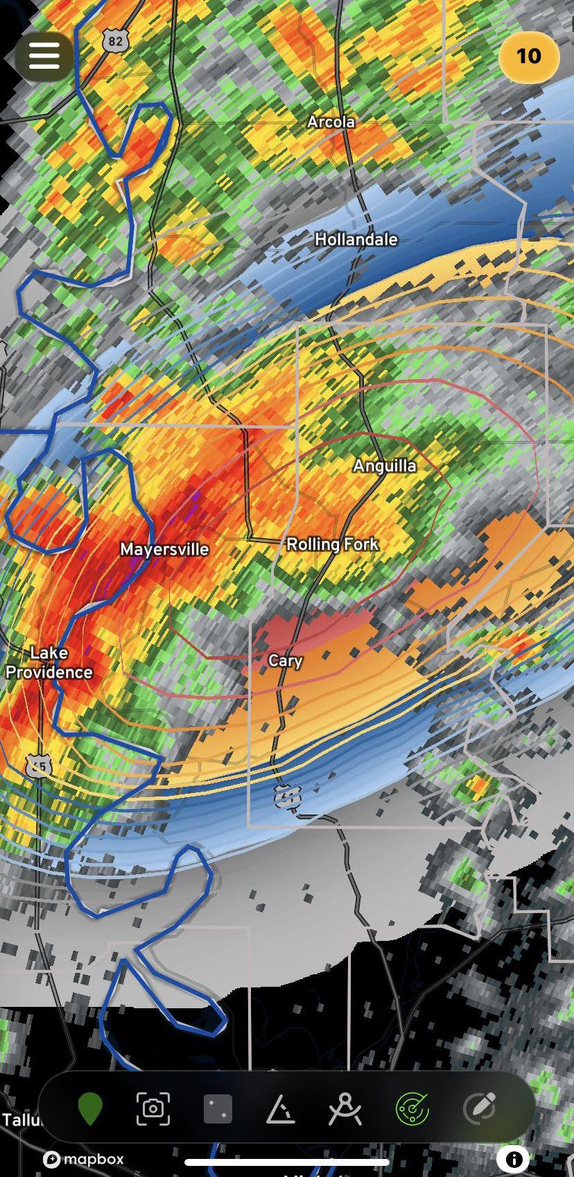
STORM-Net initialized at 00:48. (6 minutes prior to tornado warning)
20 minute lead-time for Rolling Fork, MS | Already in 95%+ and in sig-tor zone | CONSISTENT
STORM WARNED @ 00:46
ROLLING FORK WARNED @ 00:54
TOR-E @ 01:05

Slide 24
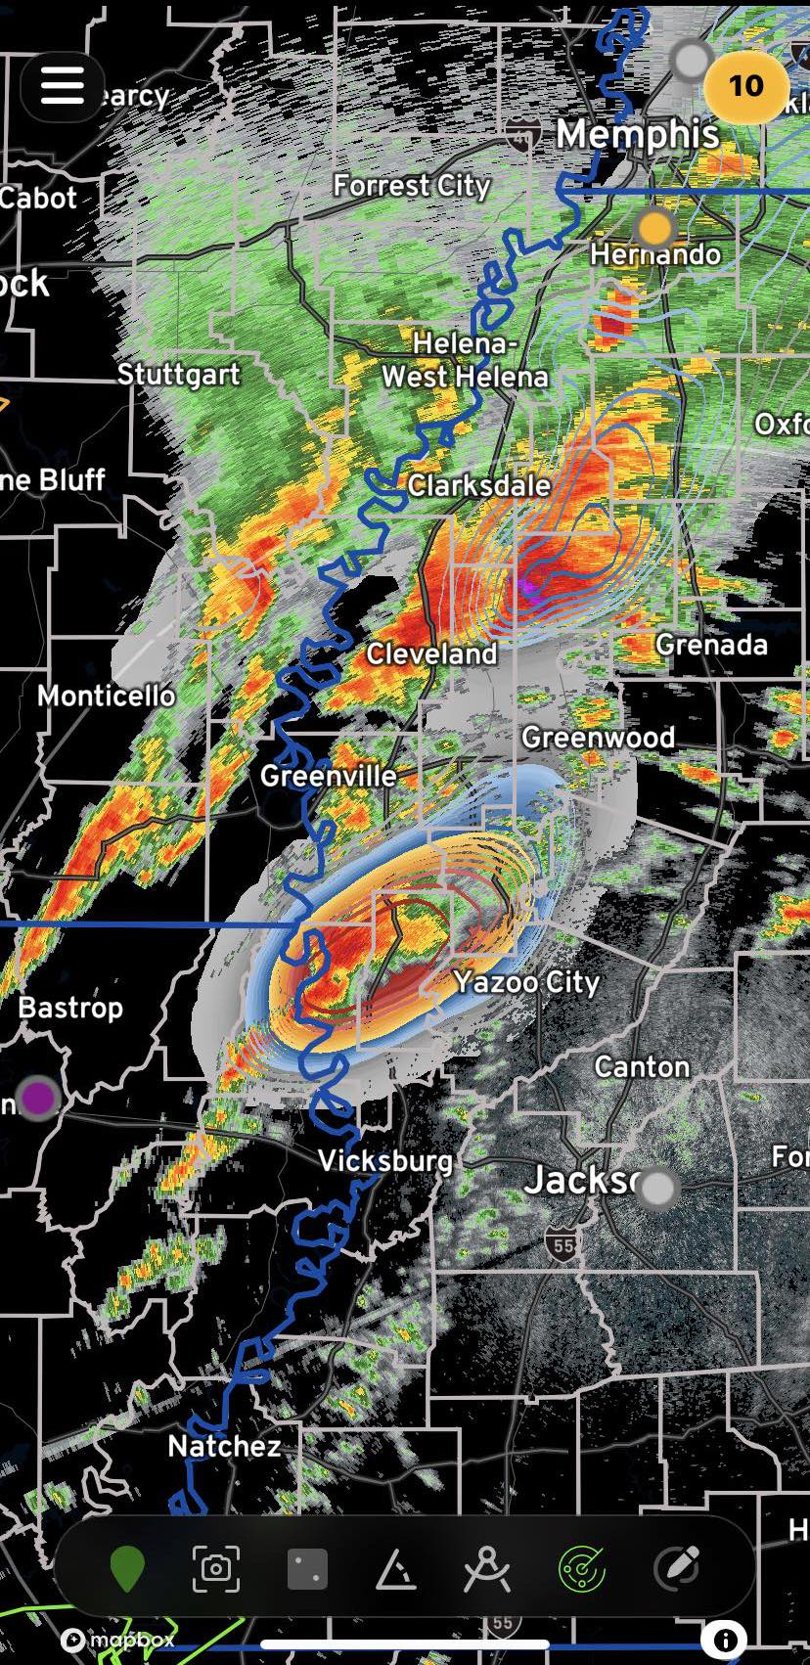
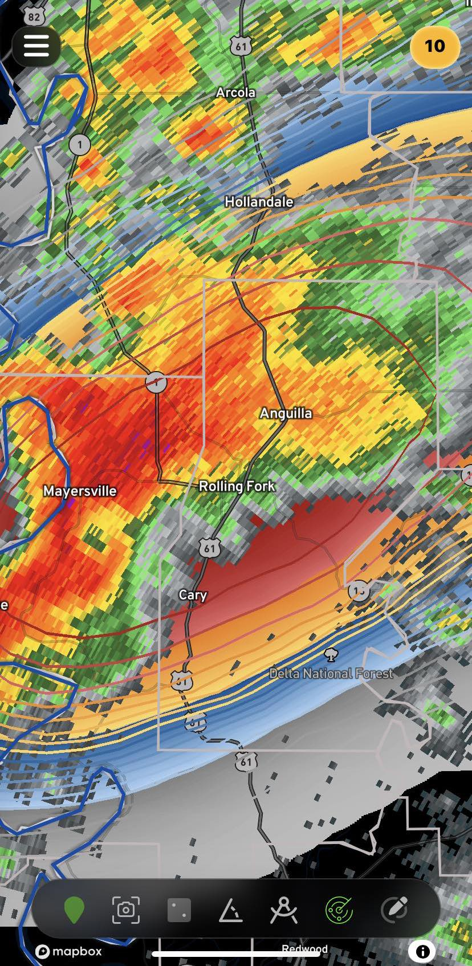
STORM-Net initialized at 00:54. (tornado warning just now issued)
14 minute lead-time for Rolling Fork, MS |Consistently in 99%+ and sig-tor zone
STORM WARNED @ 00:46
ROLLING FORK WARNED @ 00:54
TOR-E @ 01:05

Slide 25
MANY SUCH CASES
There are many cases of archived test cases as well as real-time runs where STORM-Net has done especially well.
Other archived tornado test cases
  Cookeville, TN (Mar 2020)
  Mayfield, KY (Dec 2021)
  Bowling Green, KY (Dec 2021)
  Griffin, GA (Jan 2023)
  Keota, IA (Mar 2023)
  Indianola, IA (Apr 2023)
Real-time Examples
  Evansville, WI (Feb 2024)
  Little Rock, AR (Feb 2024)
  Seneca, SC (Feb 2024)
  Battle Creek, MI (Feb 2024)
  Hot Springs Village, AR (Mar 2024)
  Wapakoneta, OH (Mar 2024)
  Tornado outbreak (Apr 25-27 2024)

Slide 26
What’s next?
STORM-Net v2 is in the works!
  Increased grid resolution of inputs to 600m (0.6km)
  Significant increase in compute requirements
  More precise predictions (prob of tornado within 5 miles instead of within 10 miles)
  At least 16x more training data
  Outputs for probability of any tornado (any EF), significant tornado (EF2+), and intense tornado (EF3+).
  Updates every 2 to 5 minutes, similar to SN v1
HurricaneVision to be released this month!
  State-of-the-art AI hurricane model is in the works.
  Similar to STORM-Net with probability map outputs for cyclone intensity and track
Lightning, precipitation, and snowfall models coming 2024-25
Hemispheric or global AI model similar to GraphCast/Pangu/AIFS

Slide 27
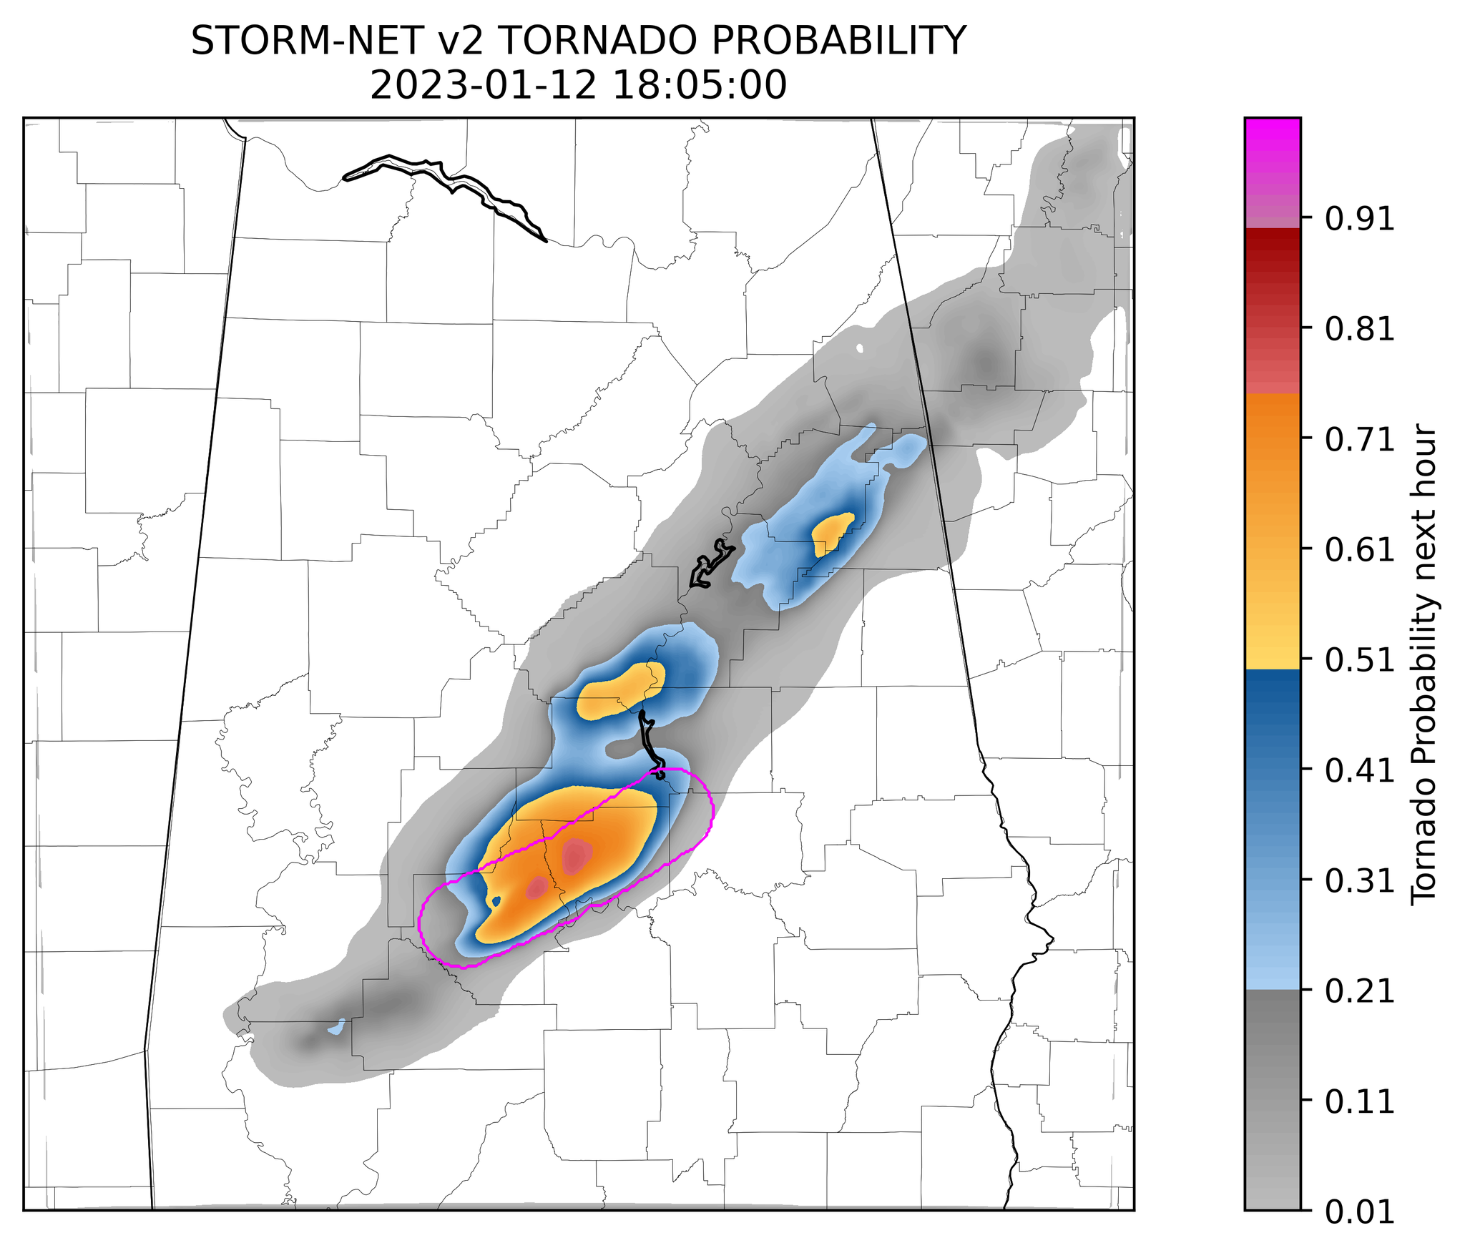
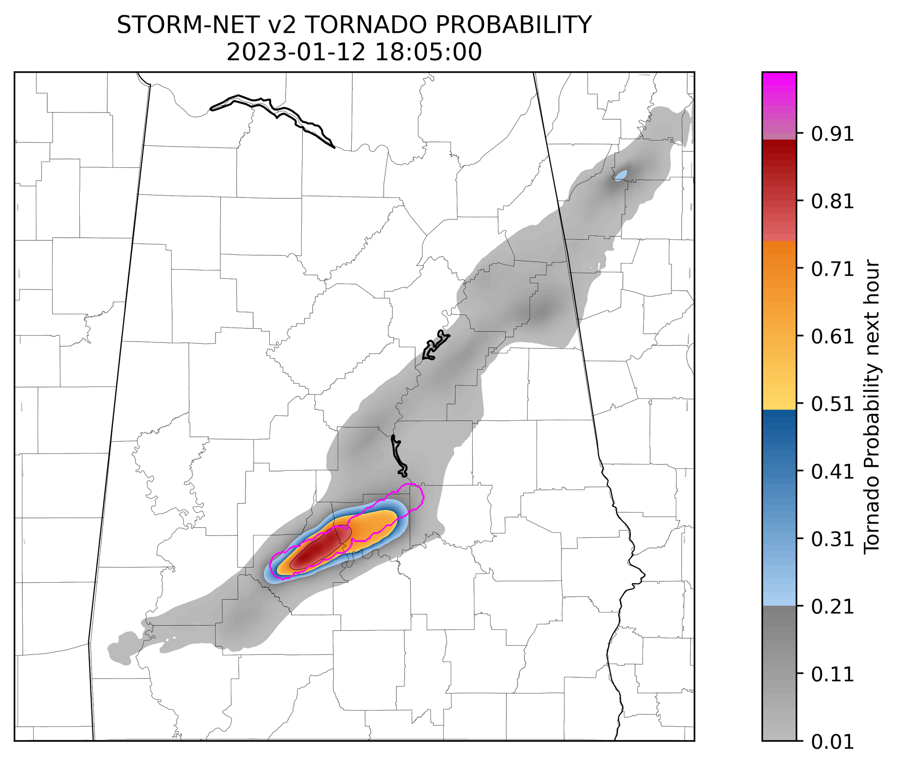
10-MILE VS 5-MILE PRECISION
10 mi precision
Currently in use
5 mi precision
Implemented in SNv2

Slide 28
Hurricane-VISION
State-of-the-art hurricane prediction model
Uses deep-learning to predict tropical cyclone probabilities
  Track within 200km
  Track within 100km
  Intensity along track
  Longevity (does not predict a fixed path length, predicts cyclone’s life from present to end of cyclone’s life)
Able to visualize most likely track and intensity with certainty factored in.
Updates hourly.

Slide 29
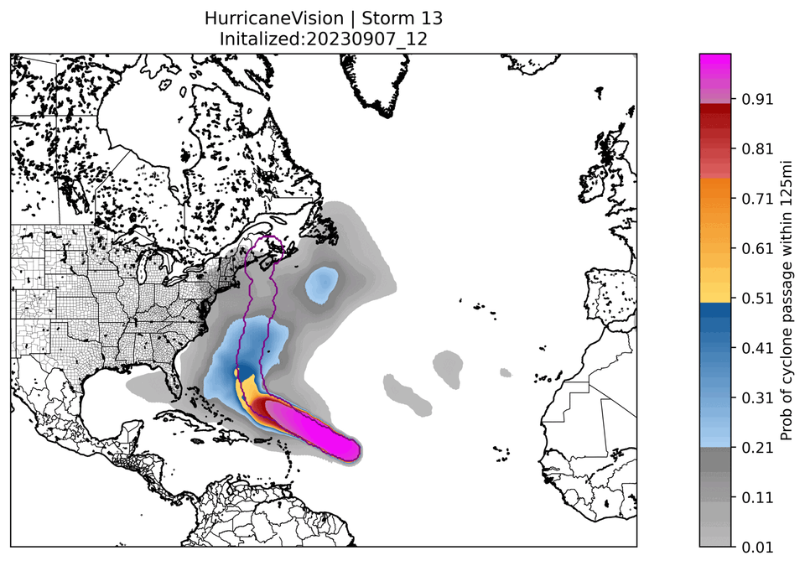
Hurricane-Vision | Hurricane lee 2023 200km track forecast loop

Slide 30
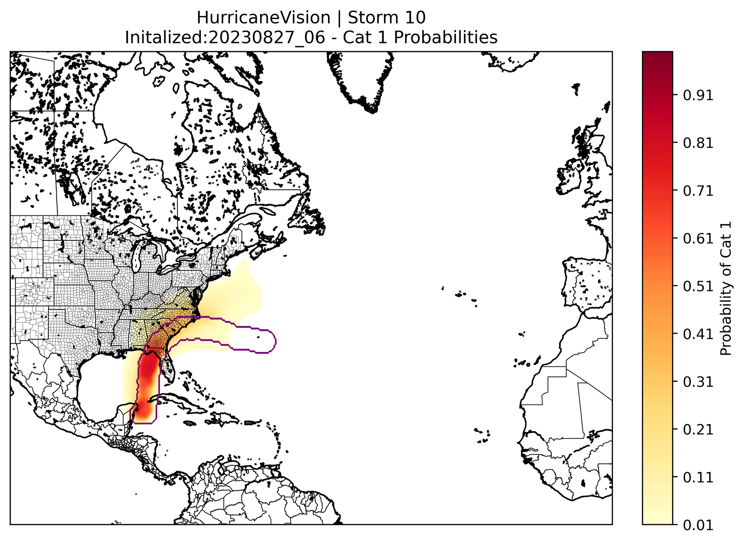
Hurricane-vision | hurricane idalia 2023 intensity forecast

Slide 31
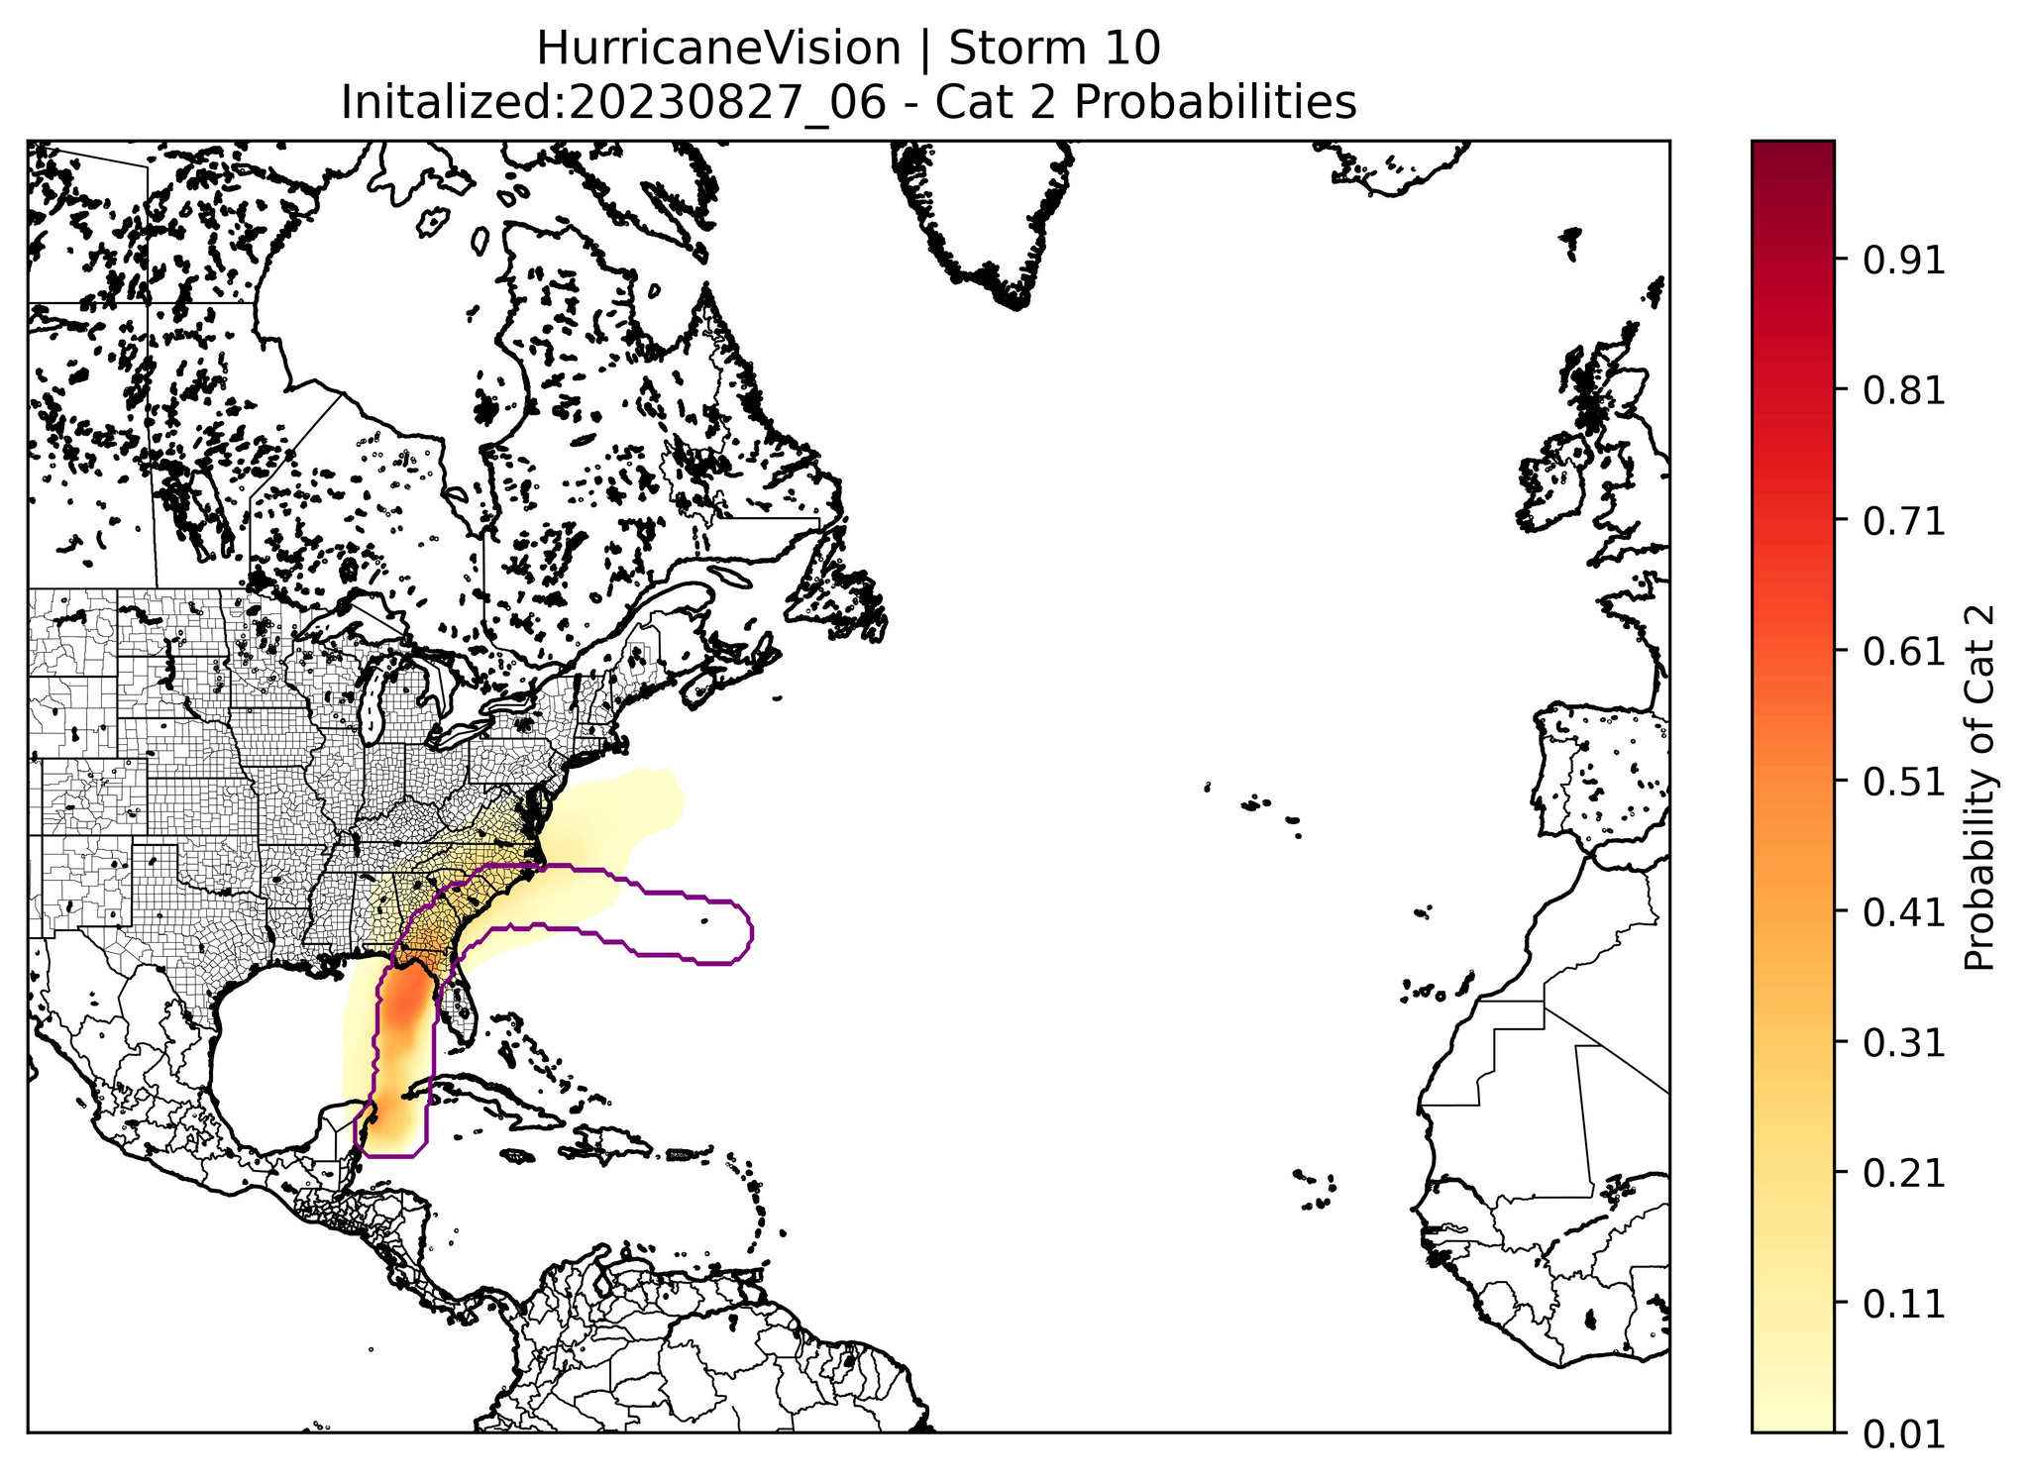
Hurricane-vision | hurricane idalia 2023 intensity forecast

Slide 32

Hurricane-vision | hurricane idalia 2023 intensity forecast

Slide 33

Hurricane-vision | hurricane idalia 2023 intensity forecast

Slide 34
More info
More info, including live data, raw test data, and raw realtime data is available on our website: https://mesoscaleforecast.com/storm-net/

