Slide 1

Reimagining Severe Weather
Prediction

Slide 2
About atmosphere analytics
Startup focused on developing groundbreaking severe weather prediction models.
Founded by Andrew Brady in 2018 as a personal project after graduating high school.
Has grown over time with new developments, especially in 2024.
No employees currently, solely the founder, Brady, who is now able to work on it full-time.
No external funding to date, only revenue from sales.

Slide 3
The state of severe weather prediction
13 minute average tornado lead-time
75% tornado warning false-alarm rate
Multiple missed/unwarned tornadoes each year
287mi average error in hurricane path forecasts (2023)
17mph average error in hurricane max wind intensity (2023)
Ever-dropping trust in weather forecasts
Confusing watch/warning/advisory/alert terminology

Slide 4
the state of severe weather prediction tomorrow
3 hour + tornado lead-times (storm-net)
10% tornado false-alarm rate (storm-net)
Few/no unwarned tornadoes (storm-net)
62mi average hurricane track error (hv)
7mph average hurricane intensity error (hv)
Easy-to-understand probabilistic outputs

Slide 5
How?
We have developed a plethora of severe weather prediction models, which use deep machine learning
HazCast: Long-range severe storm prediction model
MMFS: AI-Enhanced Physical weather model
Storm-net: severe thunderstorm and tornado prediction model
Hurricanevision: hurricane track and intensity prediction model

Slide 6
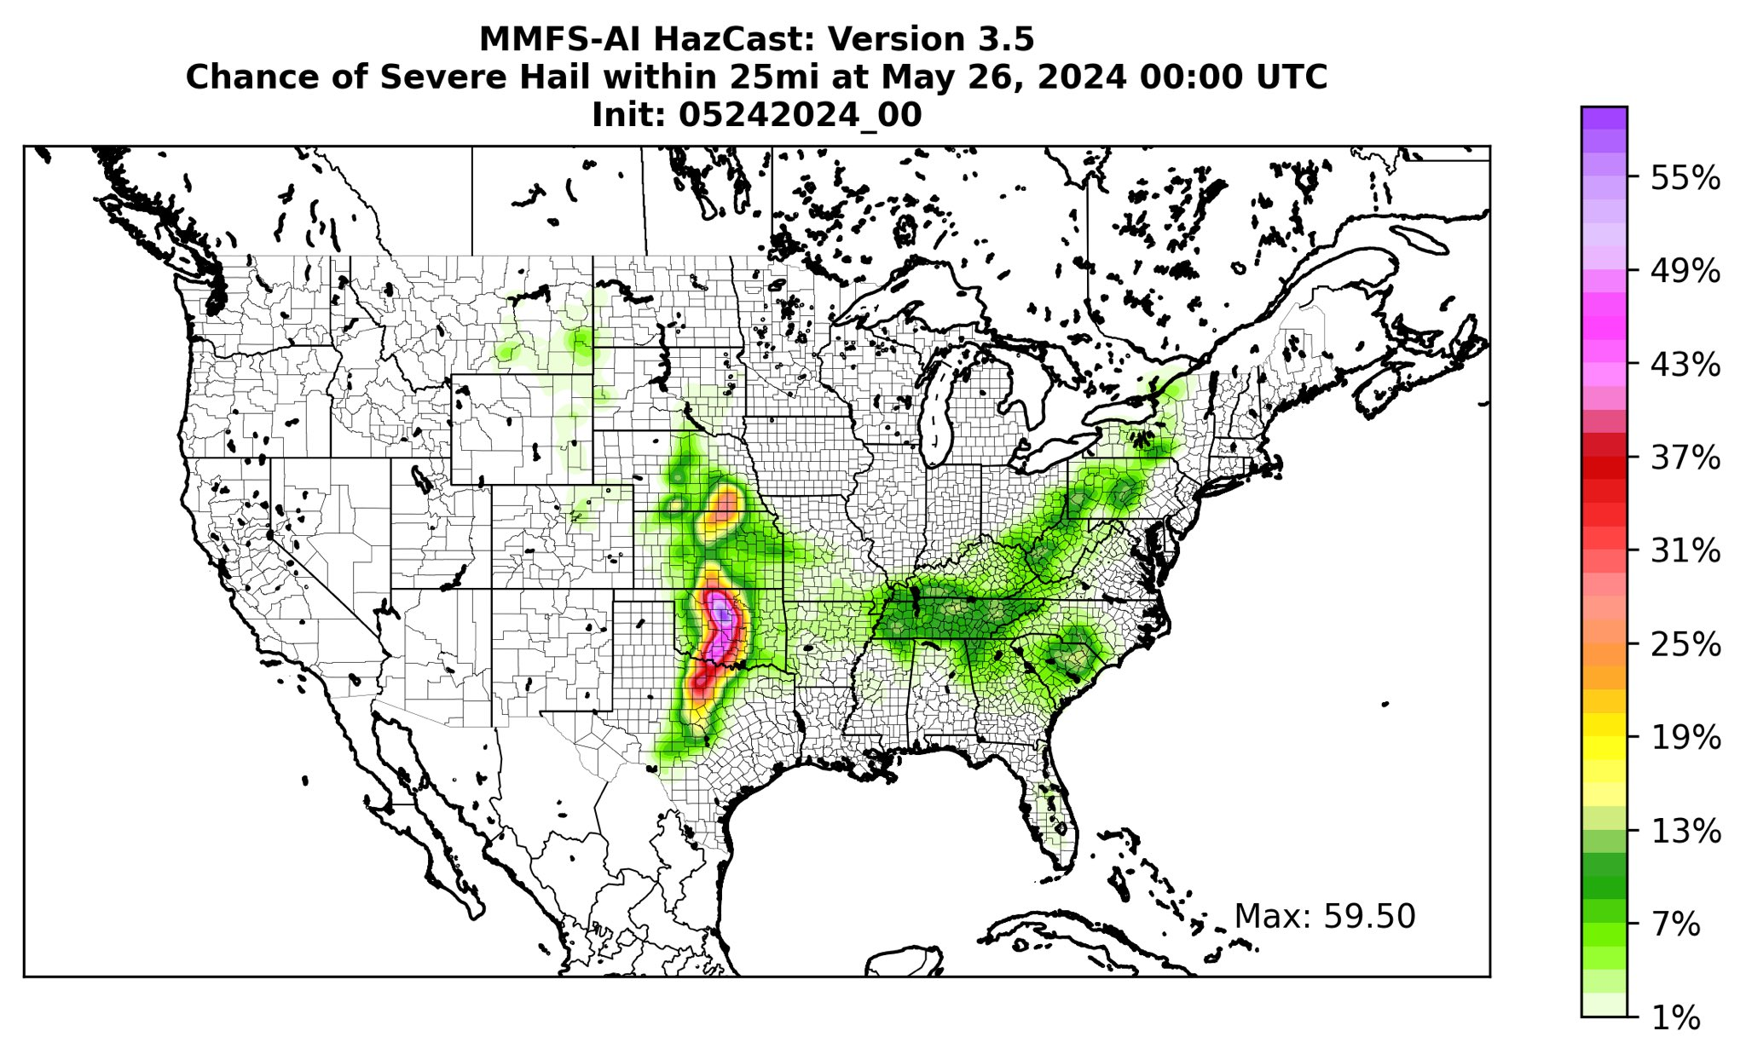
HAZCAST
Easy to understand
Chance of Severe Hail within 25 miles
On May 26th at 00:00 UTC time
Forecast initialized at 00:00 UTC on May 24th
Produces 5-day forecasts for severe weather, updating 2x daily.
Predicts where different severe weather hazards will occur every 3 hours.
  Severe Hail
  Severe Damaging Winds
  Tornadoes
Gives clients specific date/time/location of hazard.

Slide 7
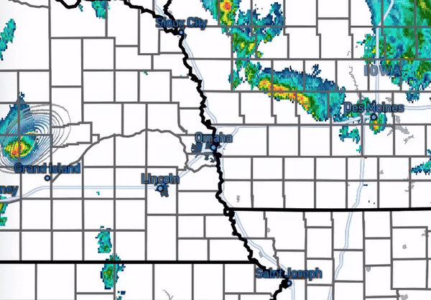
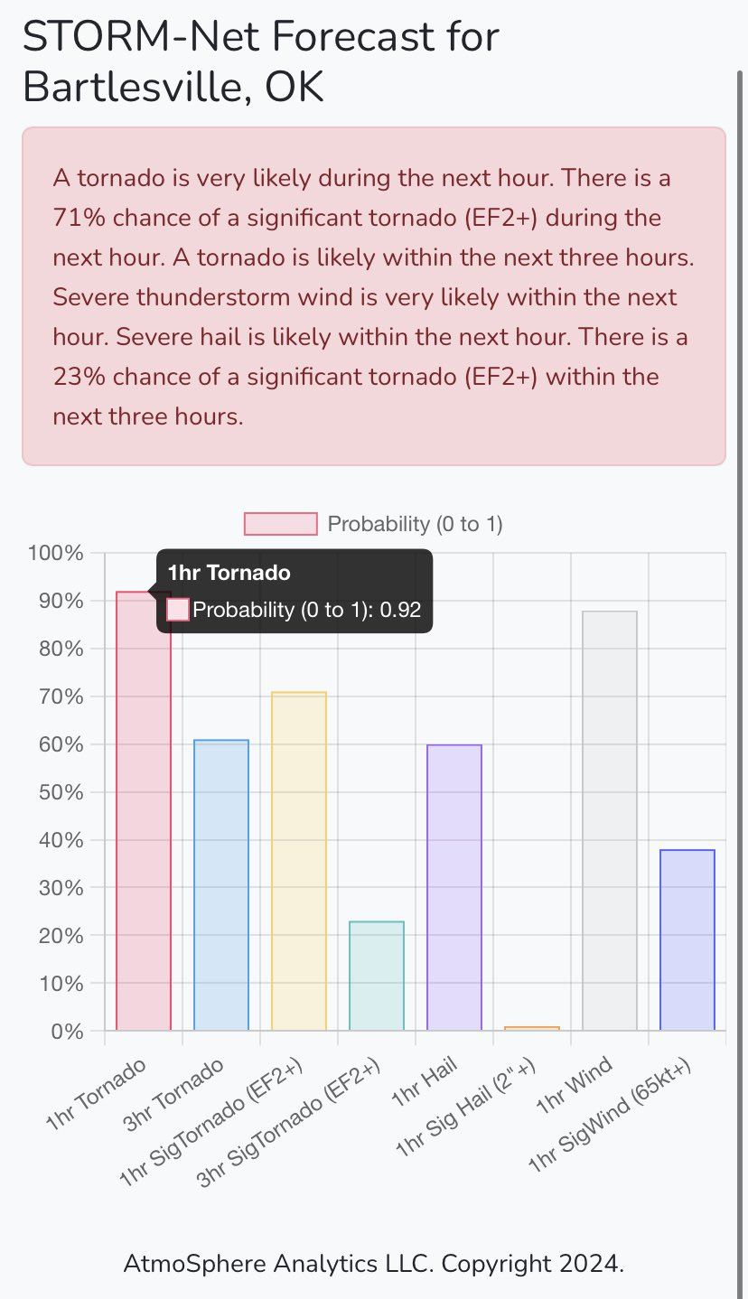
STORM-NET
Plotted is chance of tornado, overlaid with radar
April 26th, 2024 tornado outbreak in NE and IA
Can watch evolution of storms and tornado probs
State-of-the-art flagship near-term precise severe weather prediction model.
Predicts severe hazard probability & intensity with great precision on short timescales
  Predicts hazards for the next hour or 3 hours down to the neighborhood
  Severe hail, damaging wind, tornado
  As well as significant hail, destructive wind, or significant tornado
High life-saving opportunity. NOTHING else exists like this!

Slide 8
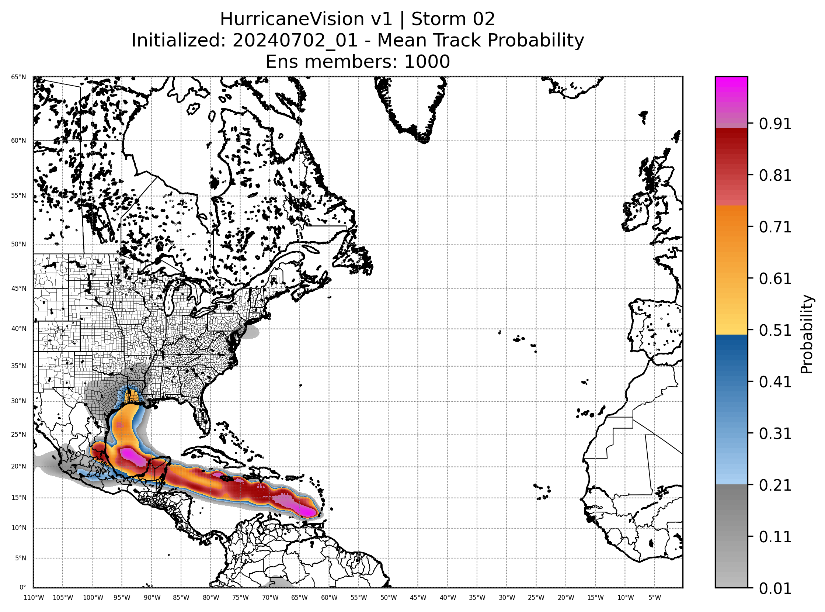
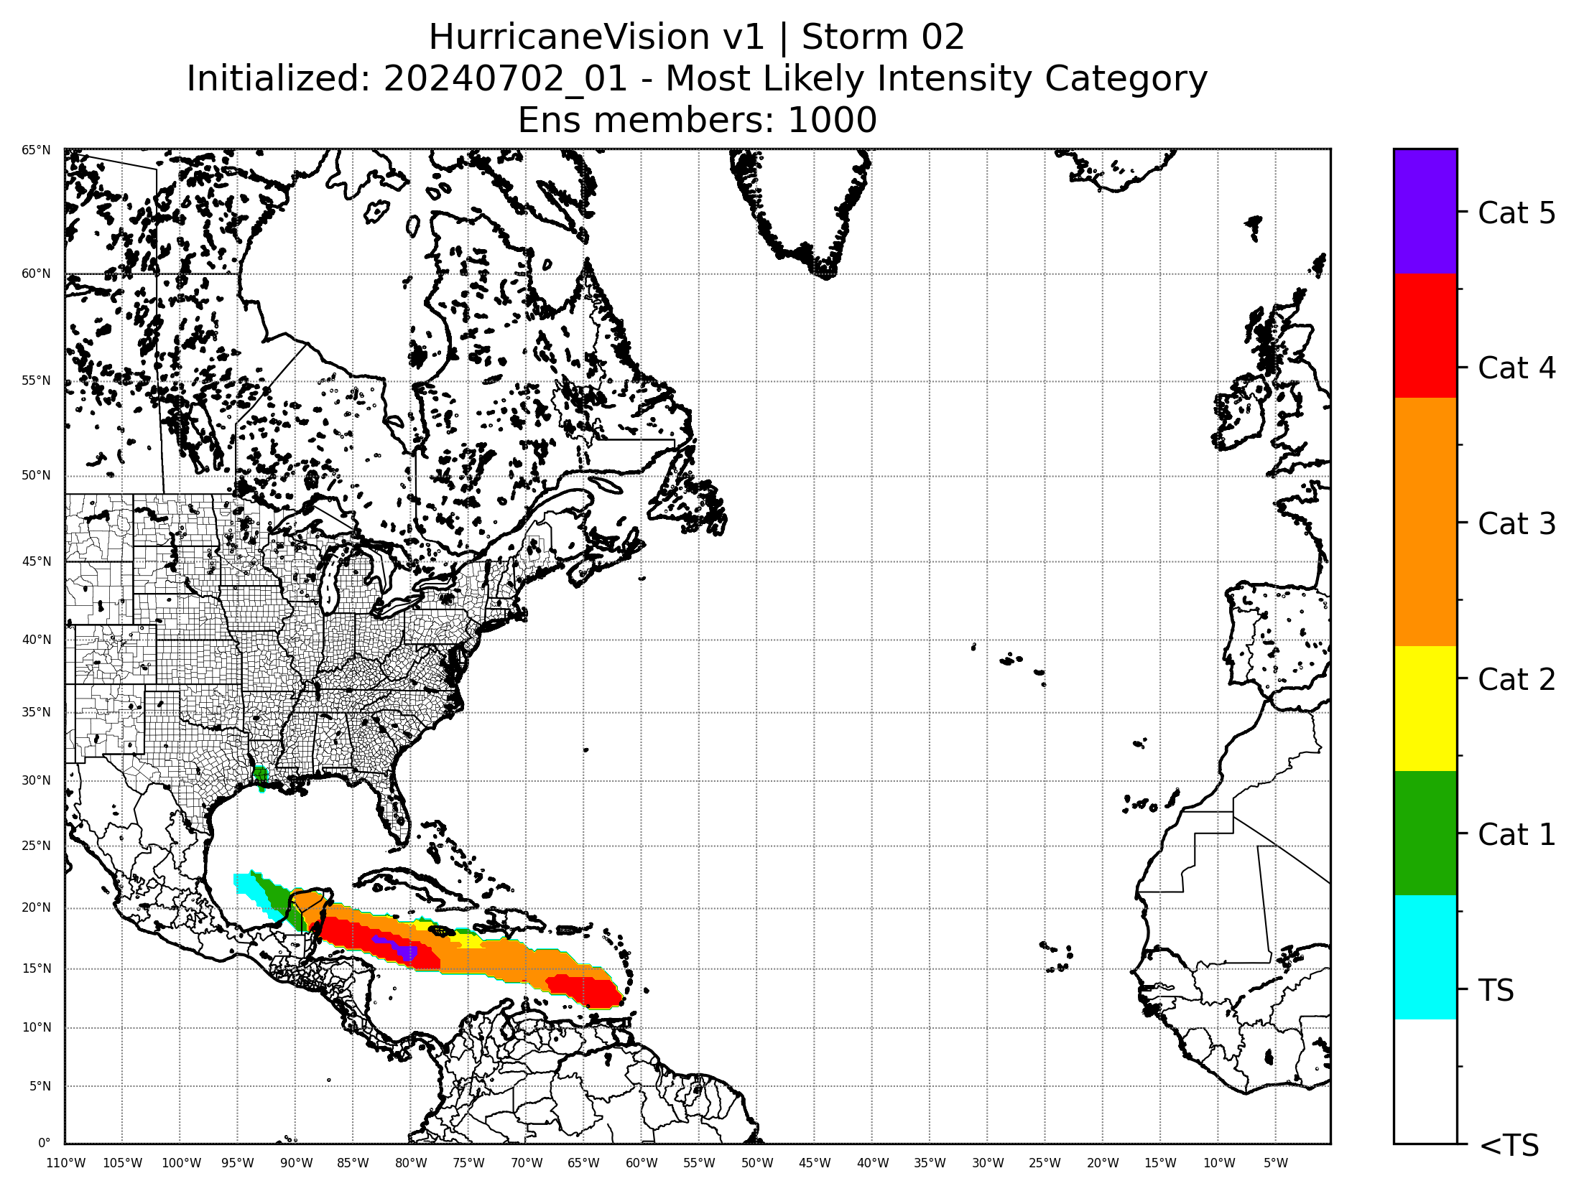
hurricanevision
Our machine-learning hurricane prediction model.
Predicts track of tropical cyclones along with intensity along the projected track
Produces intensity categorical forecasts along with probability breakdown along track.

Slide 9
Where are we right now?
Have allowed extensive testing of model outputs among meteorologists and weather companies, including National Weather Service meteorologists, TV broadcast meteorologists, and The Weather Channel
Have received very high praise from these sources and have existing & pending partnerships.
Existing partnerships with a radar app (to be announced) and local TV media companies
Pending partnership with The Weather Channel
Also have website subscribers where users pay monthly to access the data

Slide 10
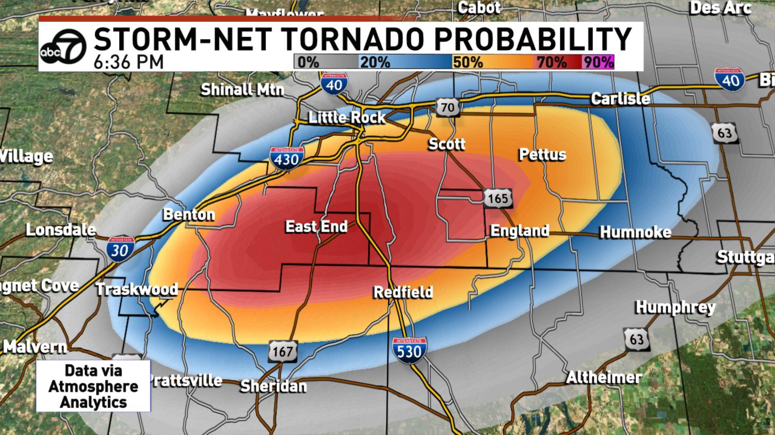
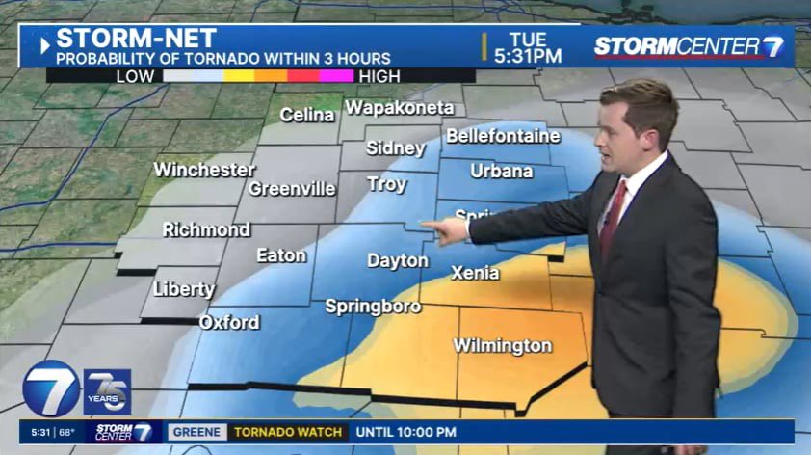

Slide 11
Where are we right now?
$40,136.86 Gross Volume YTD (thru July 1, 2024)
168 paying private customers on website
Pending large contract with The Weather Channel, possibly including media exclusivity at $120k/yr

Slide 12
Future plans
Want to hire additional help, especially on the business side of things
Initiate additional contracts, especially in emergency management
More groundbreaking models are in development. Need capital for the training & deployment of these additional model.

Slide 13
Emergency management path
Every city, county, and state in the US has an emergency management agency.
There are no competing models that predict severe weather hazards precisely in real-time.
Massively untapped market, even beyond government agencies, including private emergency management companies.

Slide 14
Push for private meteorology solutions
There is a push within the US Government to move towards private meteorology solutions over government agencies.
Most private weather companies are focusing on long range climatological/seasonal forecasting.
Very little/no competition in the short-range/emergency weather prediction market.
Immense opportunities for saving lives and building very influential models.

Slide 15
Interested to learn more?
Website: https://mesoscaleforecast.com/
Email: Andrew@mesoscaleforecast.com
Linkedin: https://www.linkedin.com/in/andrew-brady-43124015a
Personal Twitter/X: https://twitter.com/Brady_Wx
Company Twitter/X: https://twitter.com/AtmoAnalytics

